Slide 1
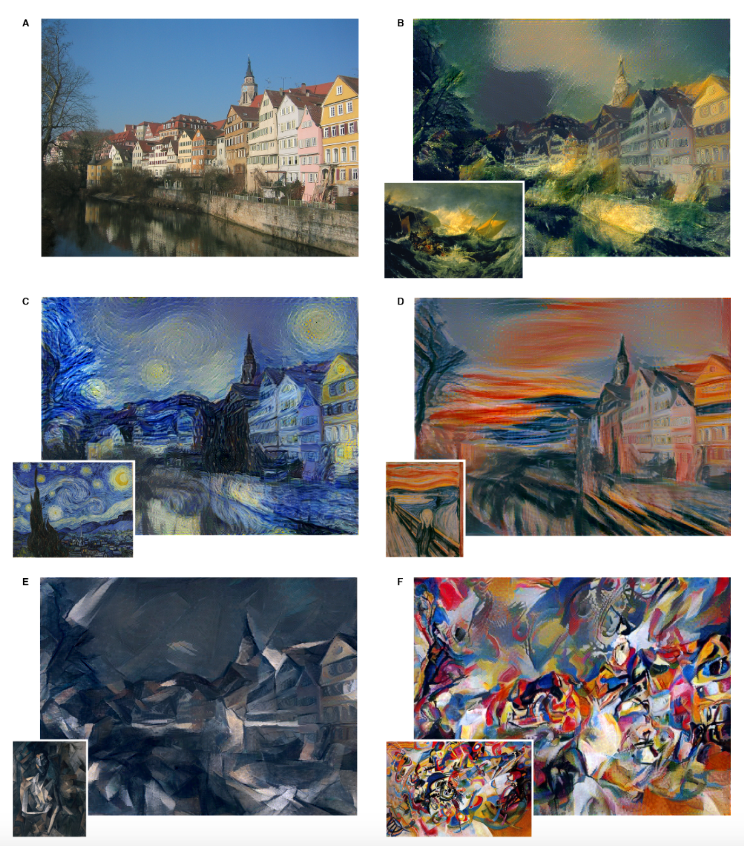
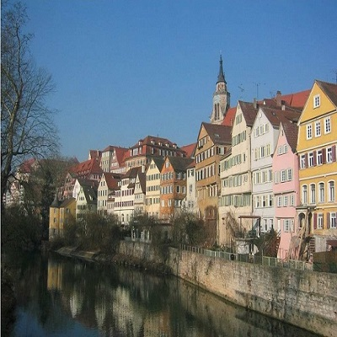
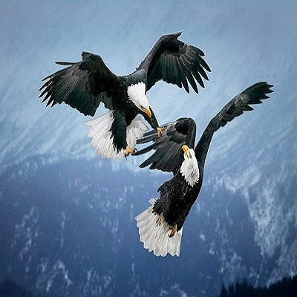

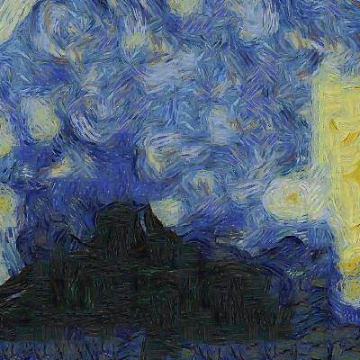
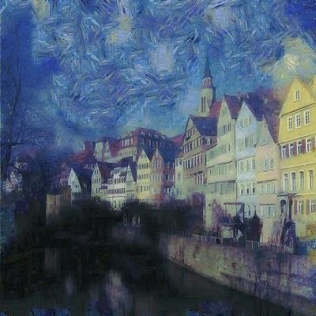
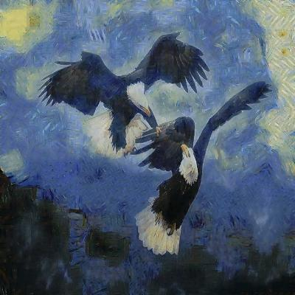
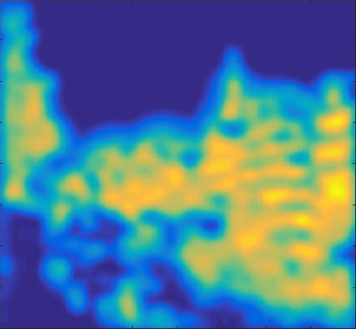
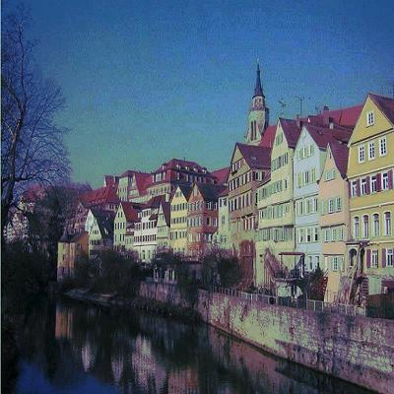
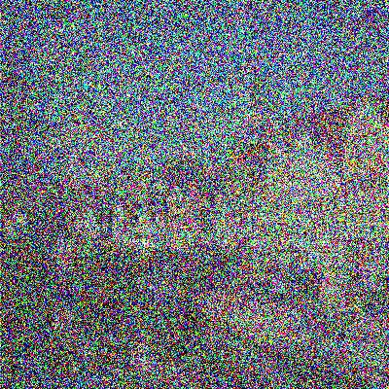
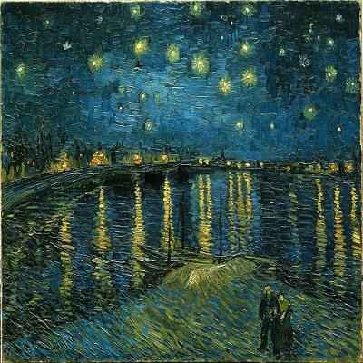
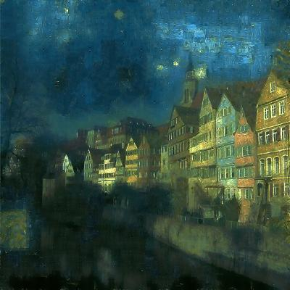
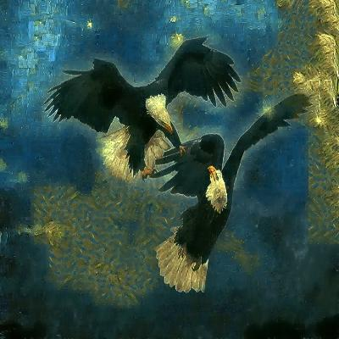
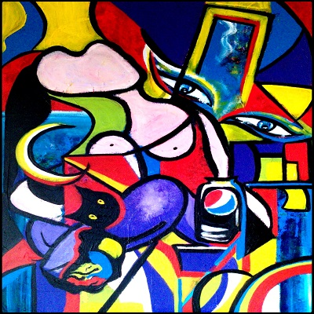
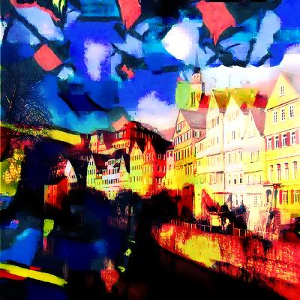
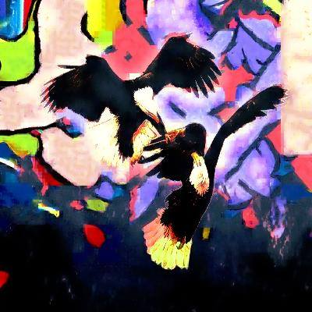
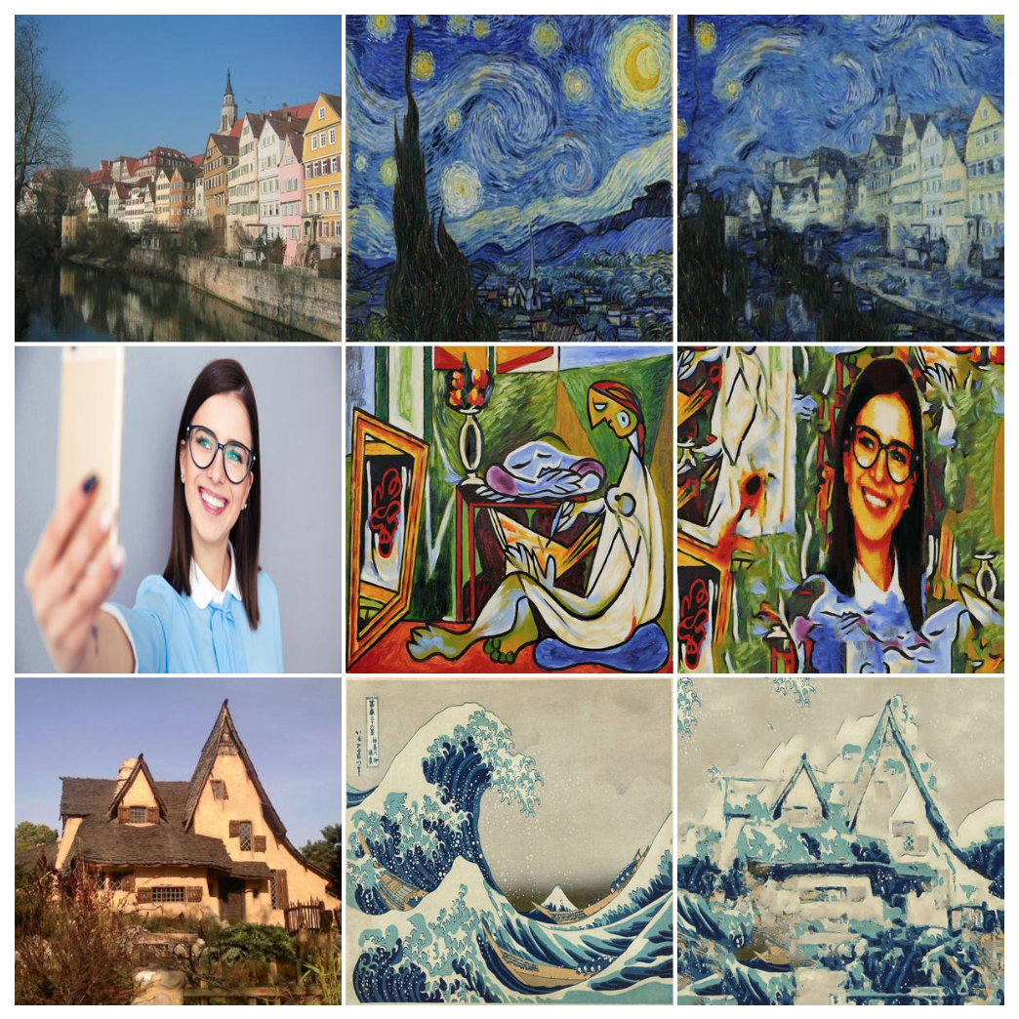

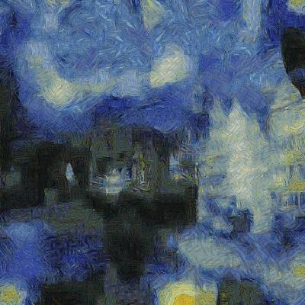
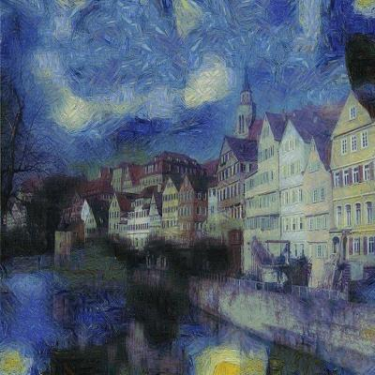
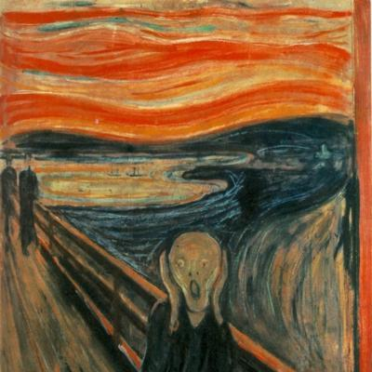
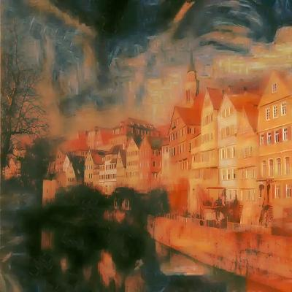
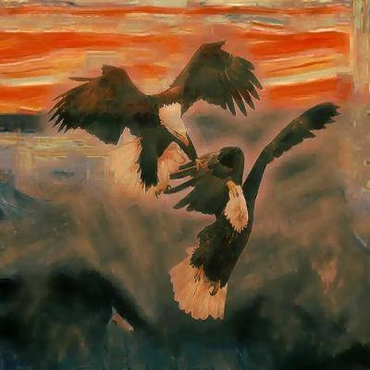
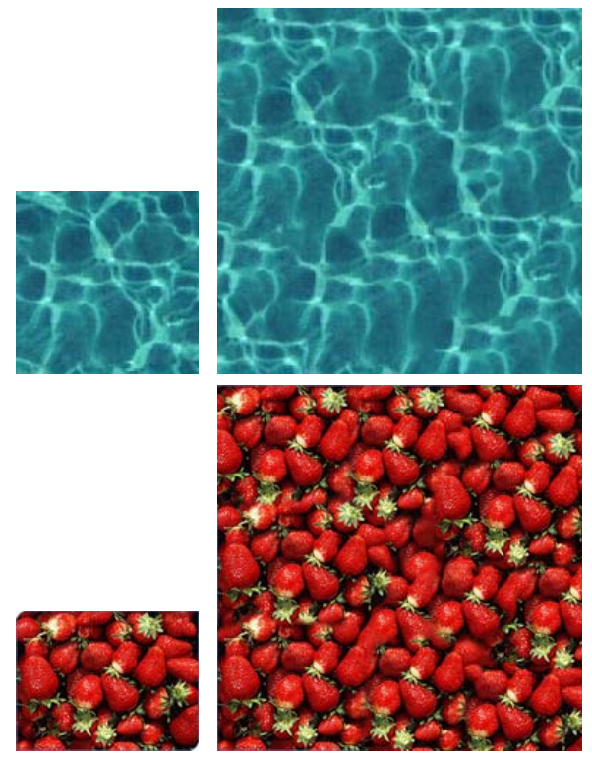
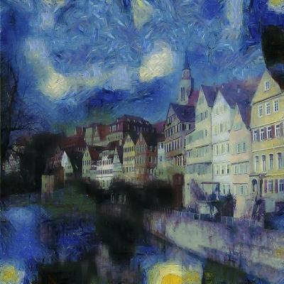
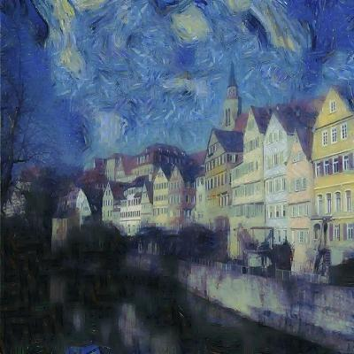
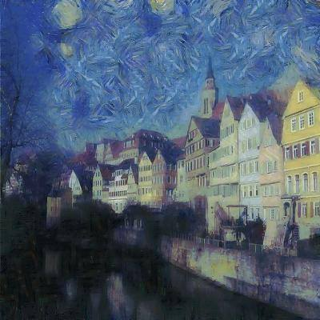
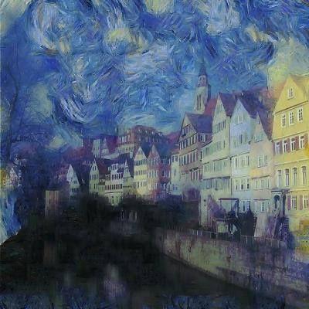
Artistic Style Transfer
Nicholas Tan, Elias Wang
Department of Electrical Engineering, Stanford University
Motivation
Algorithm Overview
Experimental Results
Leon A. Gatys, Alexander S. Ecker, Matthias Bethge
Using a biologically inspired vision model, called “Deep Neural Networks,” an artificial system can be trained to learn different styles of painting and subsequently recreate images rendered in that style.
The model is successful because it is able to distinguish between “style” vs. “content”
Input:
Content Image
Style Image
Hallucination
Content
Style
Initialization:
Chosen parameters: 3 scales, 2 patch sizes (except smallest scale uses 3 patch sizes), 10% NN noise, 25%+75% hallucination averaging
Segmentation
Color transfer
Add noise
Loop over scales:
Loop over patch sizes:
Related Work
Patch Matching
Style Synthesis
Content Fusion
Using a modification (Elad) of Texture-Synthesis (Kwatra), it is possible to get fast and comparable style-transfer results. This method focuses on separating information-poor areas to hallucinate the style and high content areas where it keeps the original image
Color Transfer
Increase patch size
Denoise
Hallucination percentage influence :
0%
10%
25%
50%
Resize Estimate (increase scale)

